Slide 1
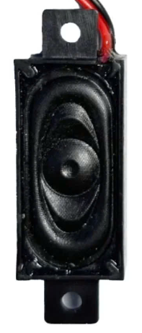
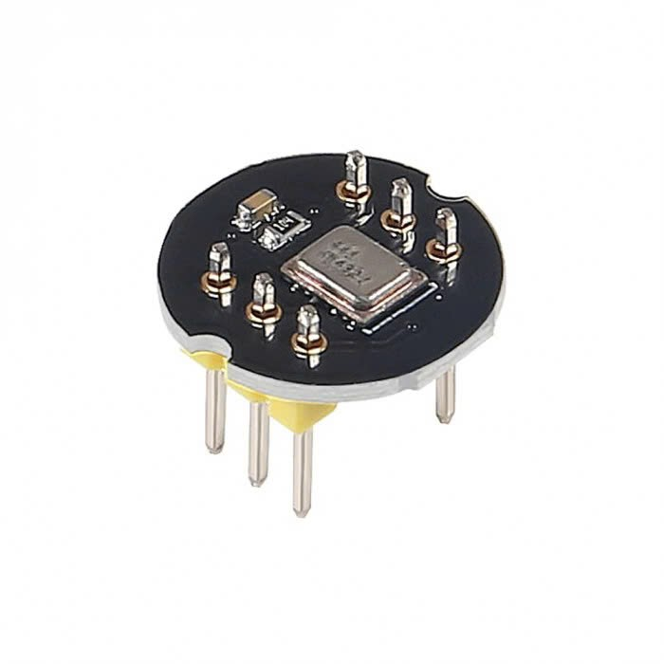
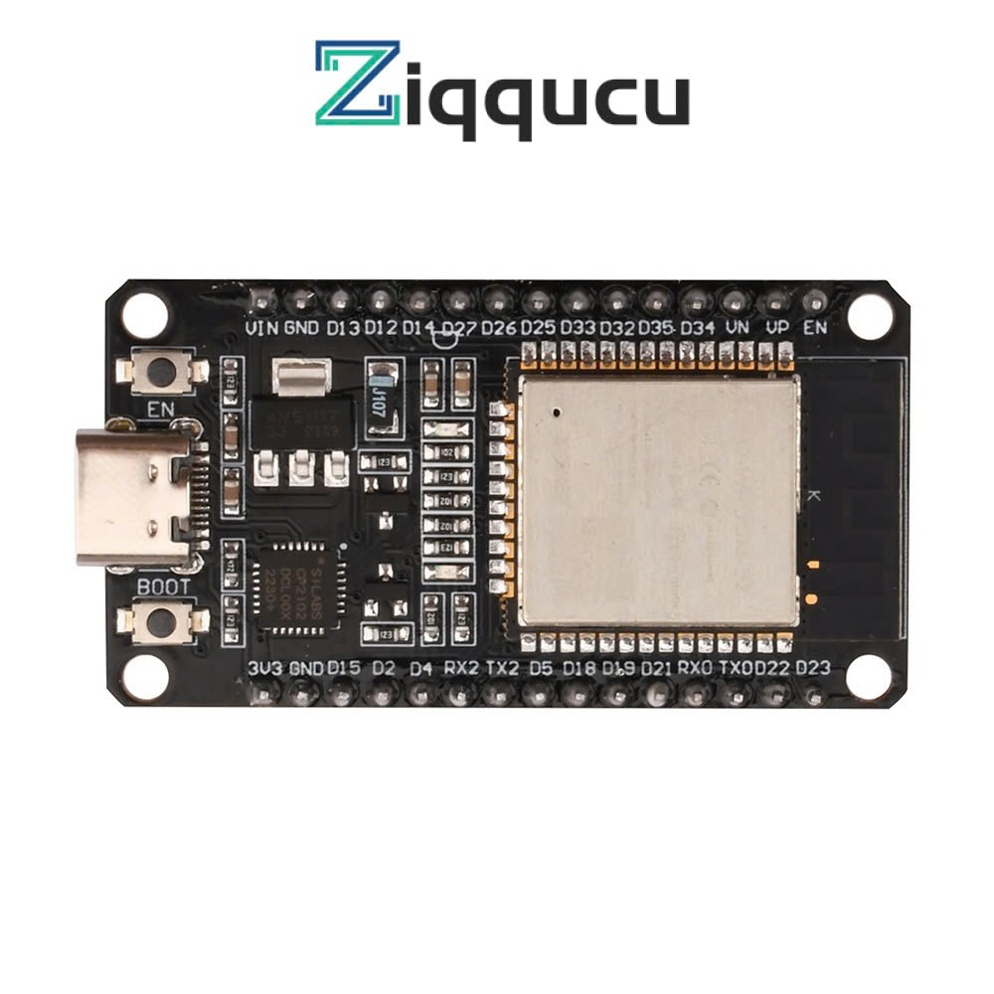
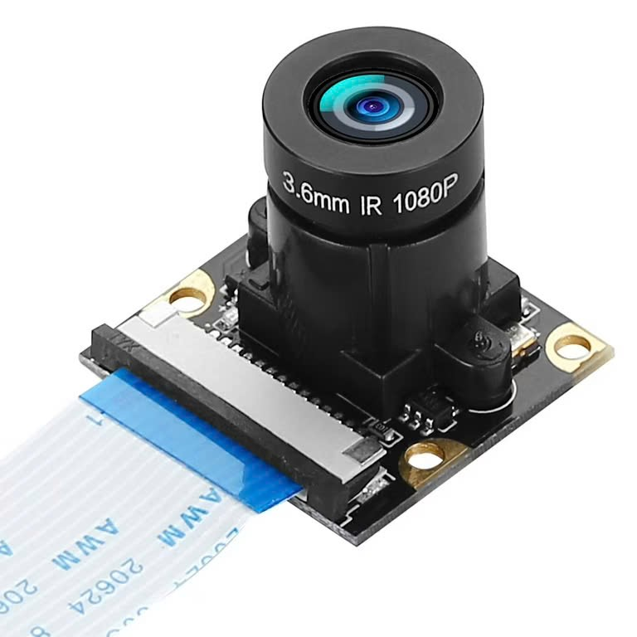
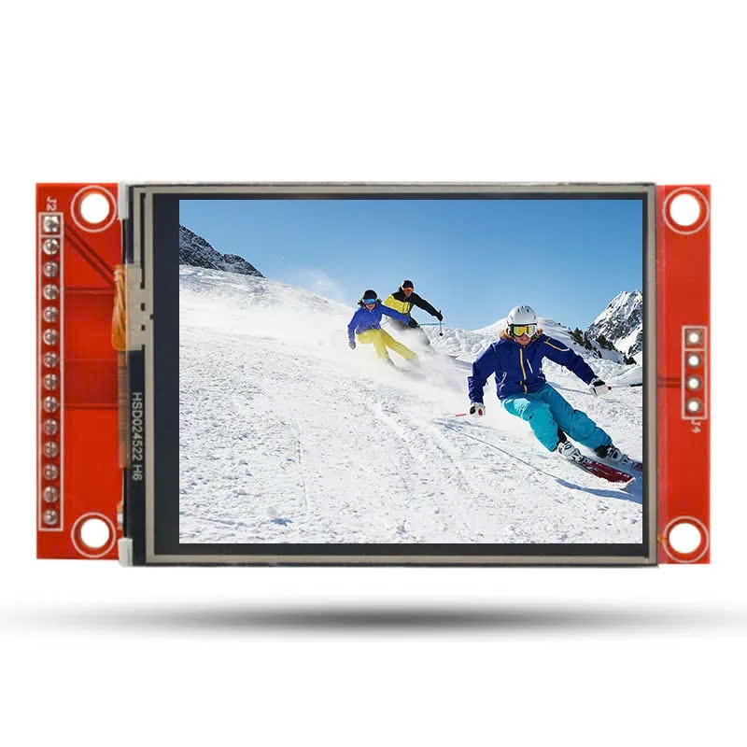
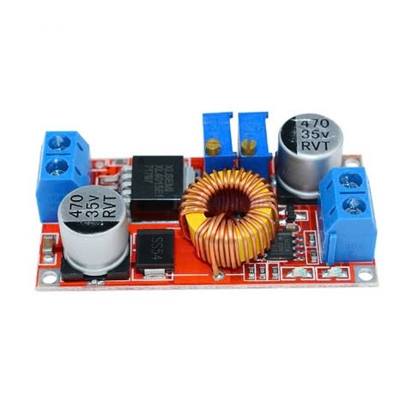
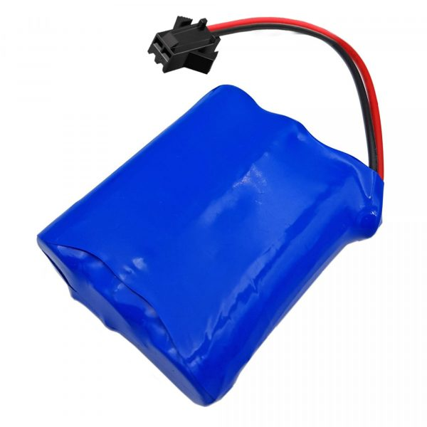
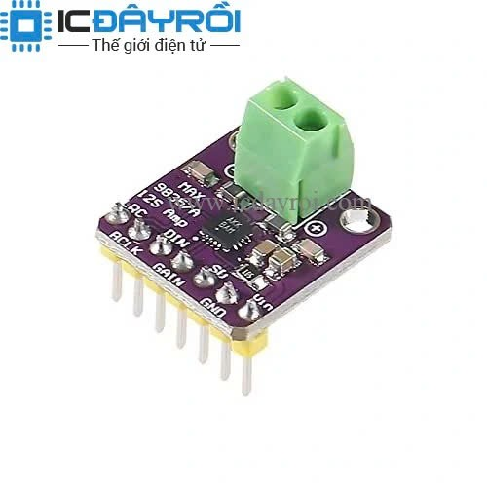
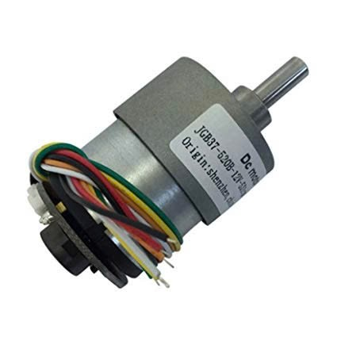
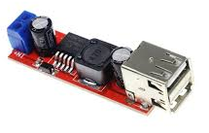
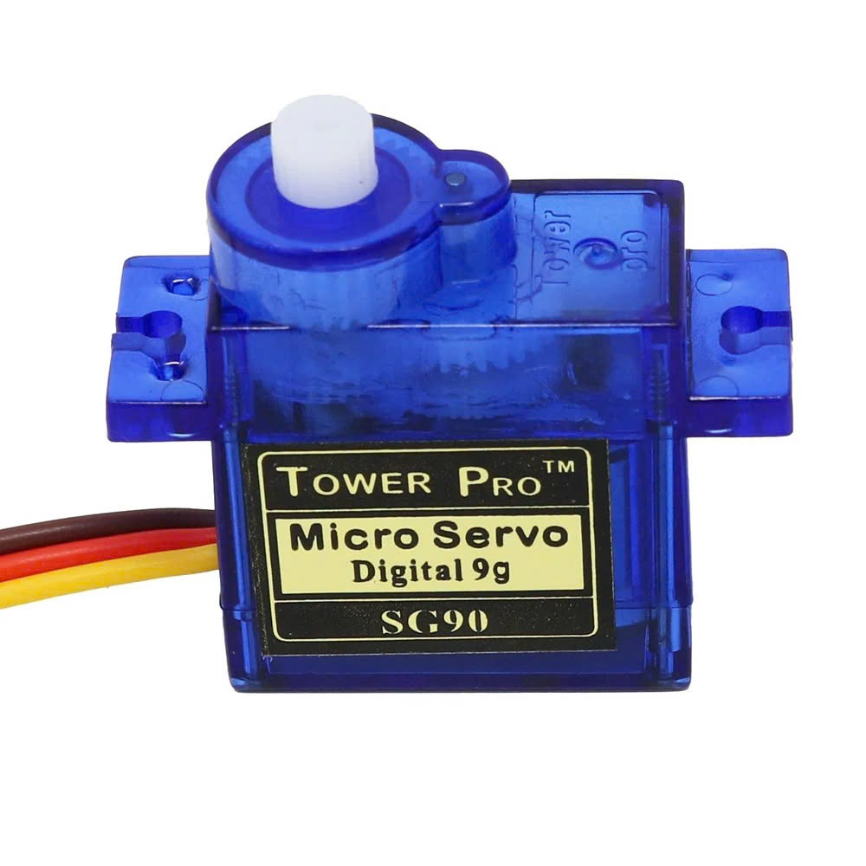
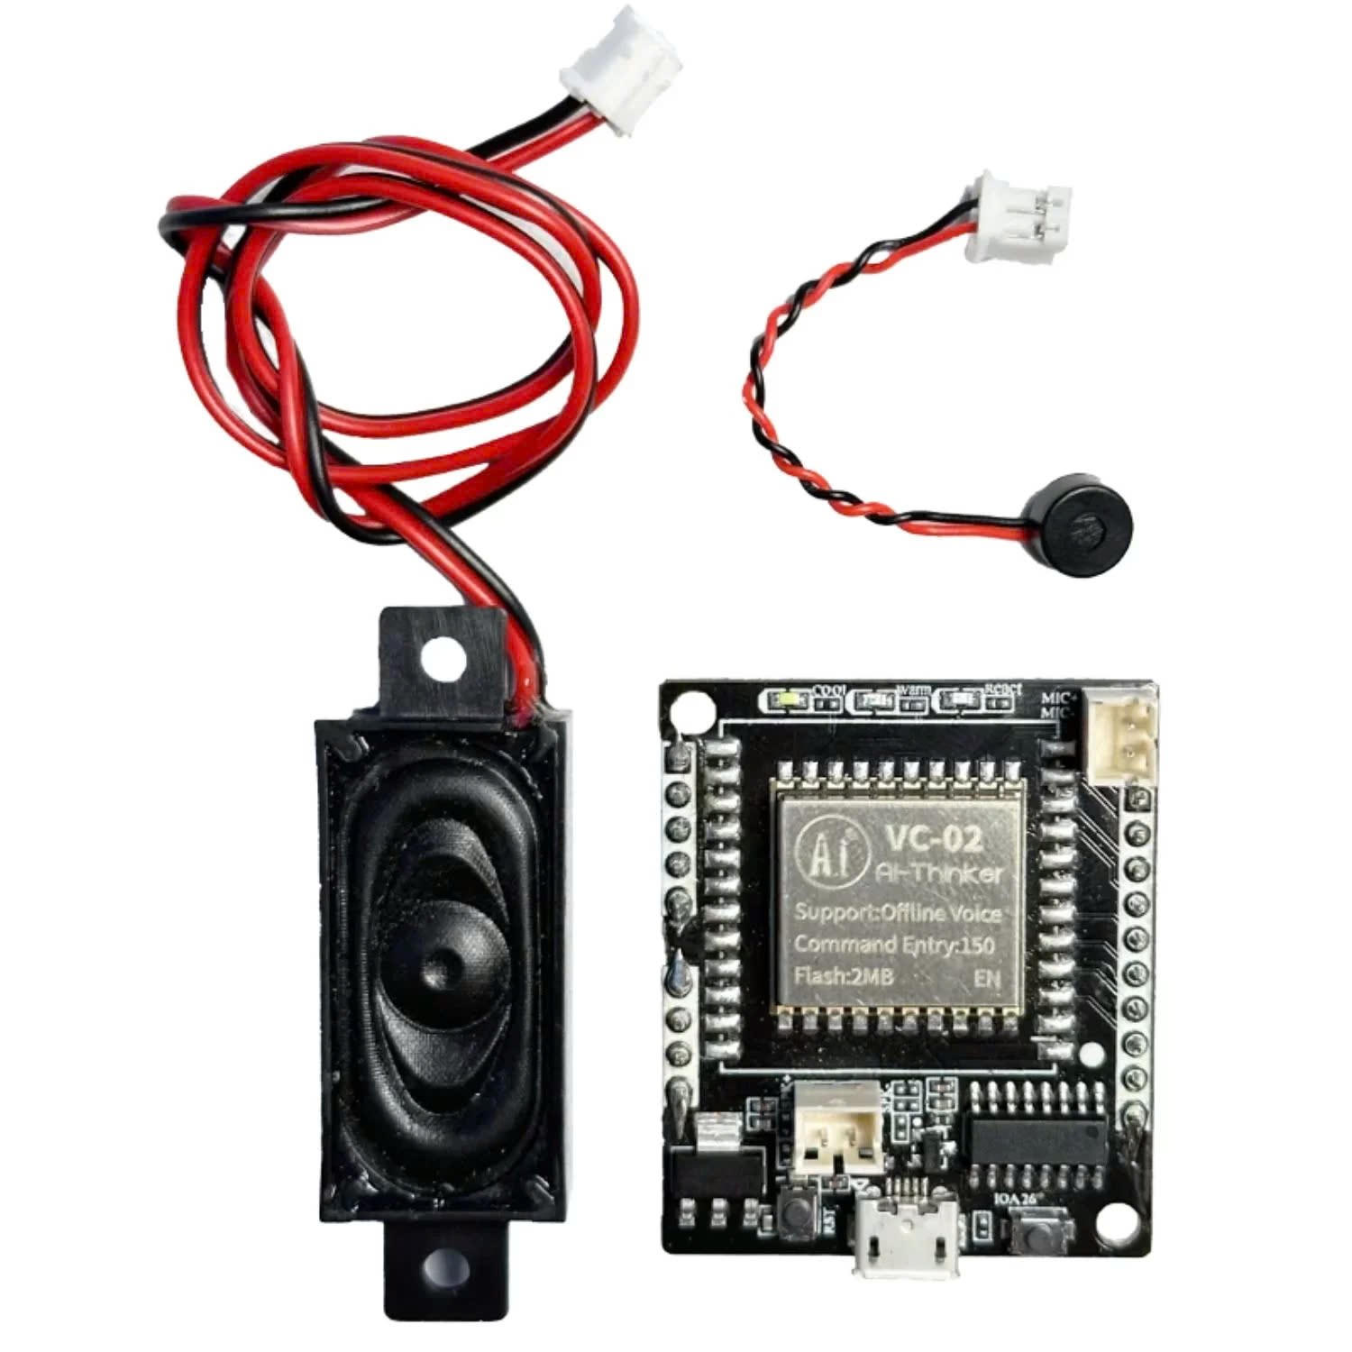
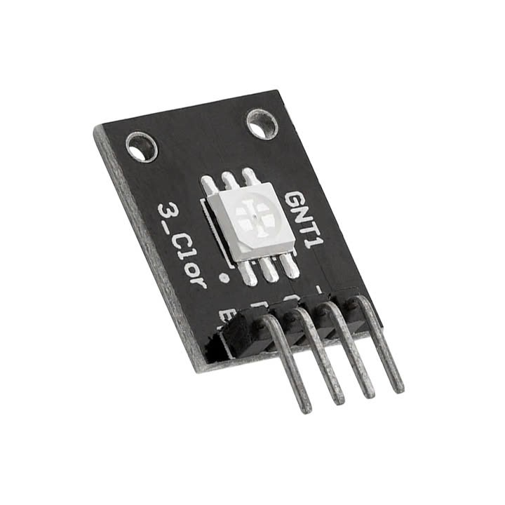
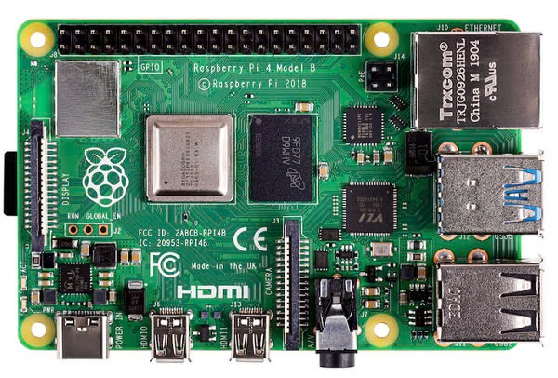
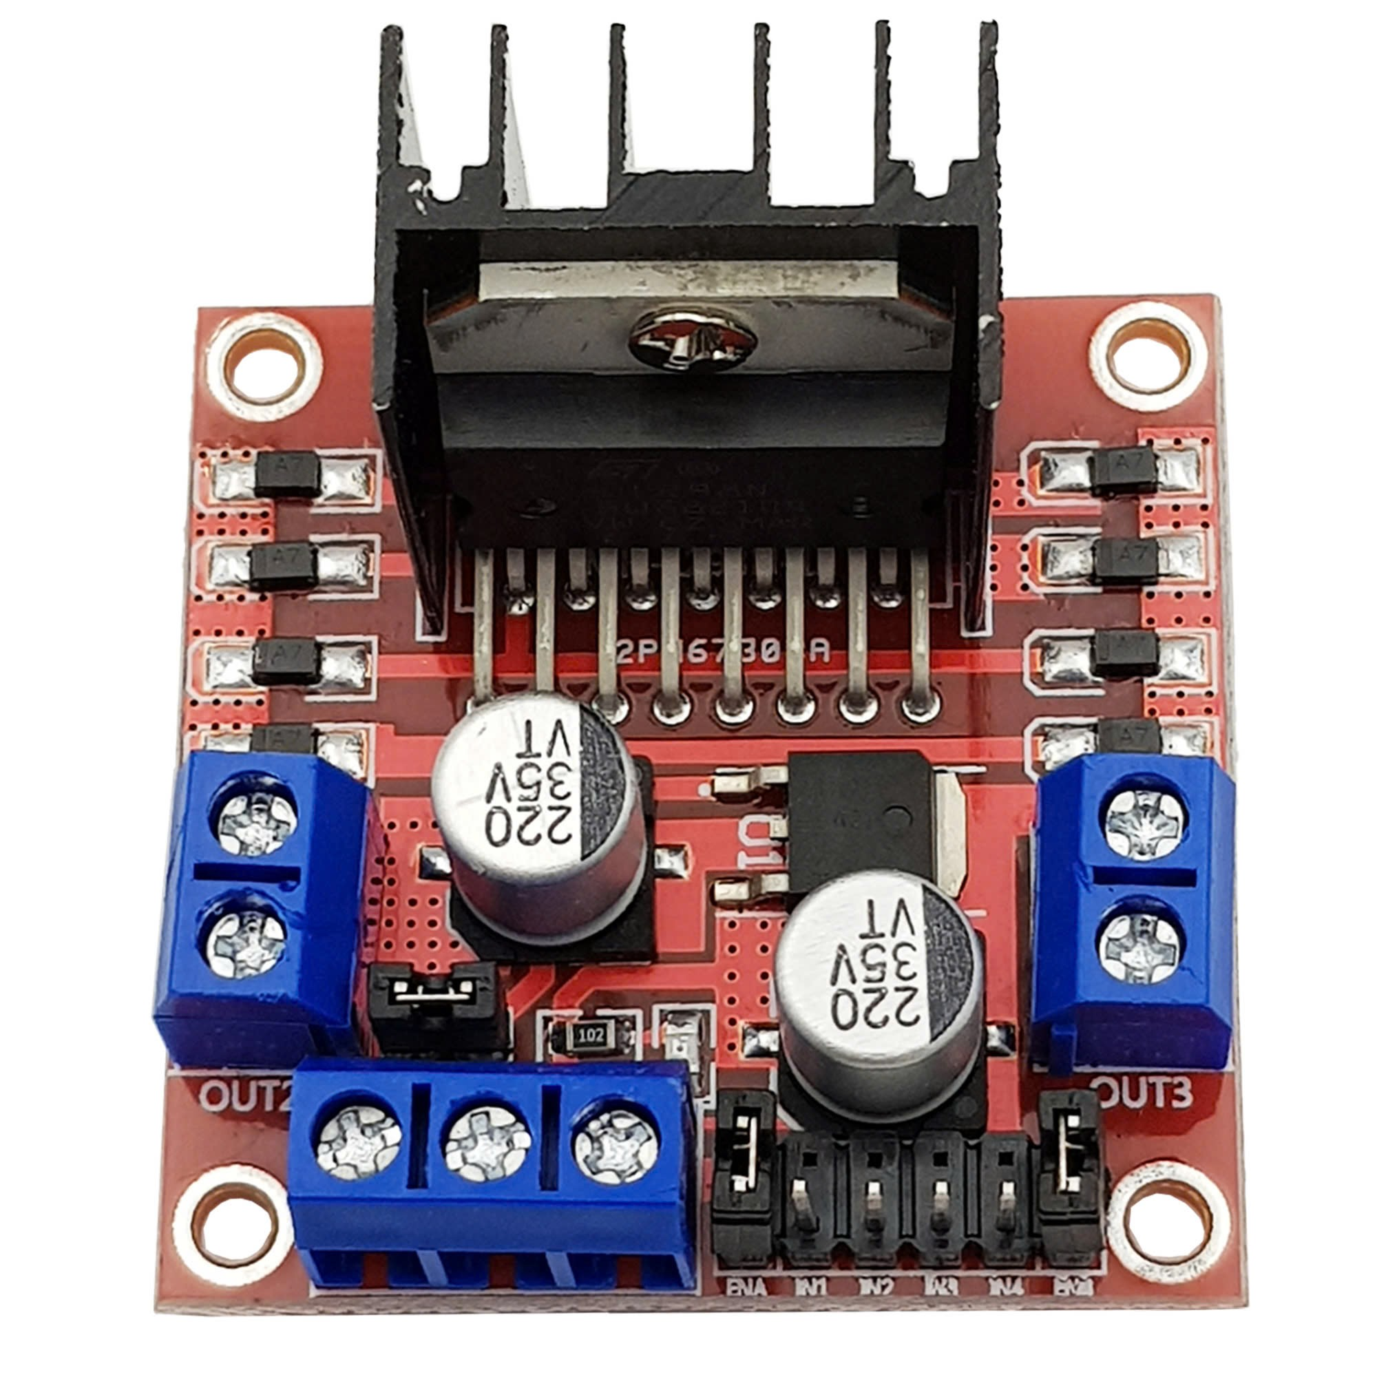
2W Speaker
INMP441 MEMS Microphone x2
ILI9341 3.2-inch screen 240x320
Camera OV5647
ESP-WROOM-32
Regulator XL4015 5V Output
18650 3S Pack
MAX98357 I2S Amplifier
LM2596S USB
5V Output
Servo Motor SG90
Servo Motor SG90
JGB37-520 x2
RGB LED
KY-009 x2
VC-02 Voice Recognition Module
L298N
Raspberrypi 4 Module B

Slide 2
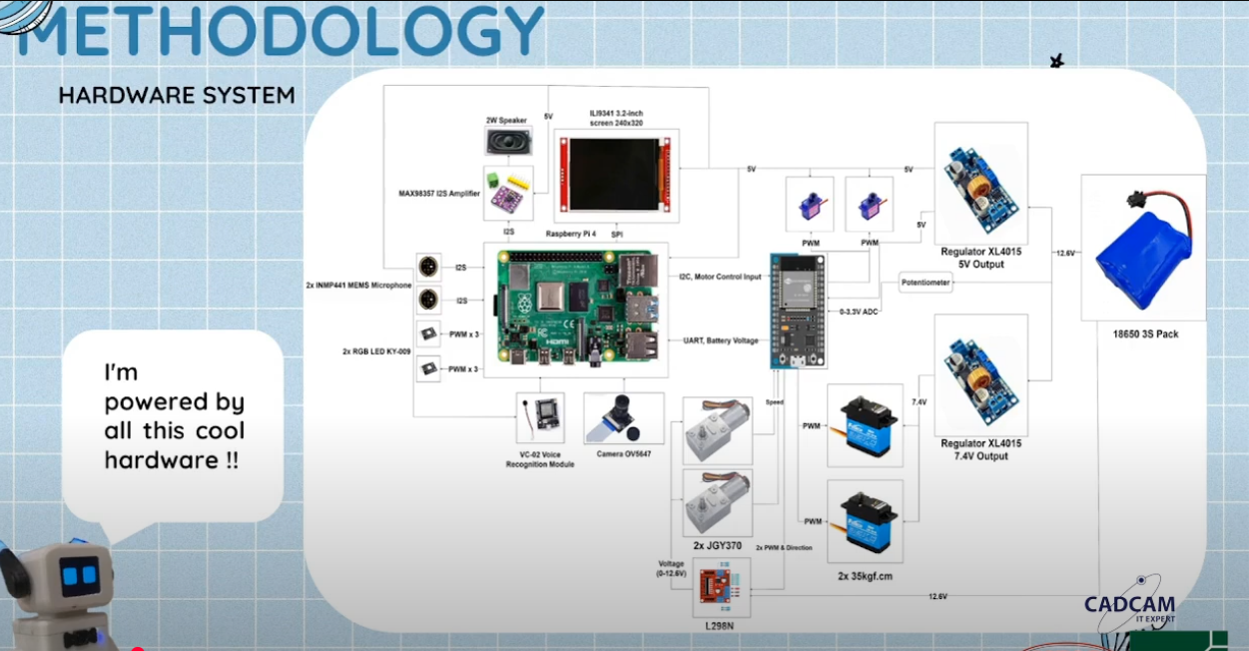

Slide 3
5V
5V
ILI9341 3.2-inch screen 240x320
5V
5V
2W Speaker
Servo Motor SG90 x2
12.6V
5V
MAX98357 I2S Amplifier
SPI
Regulator XL4015 5V Output
PWM
18650 3S Pack
5V
I2C Motor
Control Input
I2S
INMP441 MEMS Microphone x2
0-3.3V ADC
Potentionmeter
I2S
2x PWM & Direction
UART Battery Voltage
Raspberrypi 4 Module B
ESP-WROOM-32
PWM x3
12.6V
RGB LED
KY-009 x2
JGB37-520 x2
5V
VC-02 Voice Recognition Module
Voltage
(0-12.6V)
Camera OV5647
L298N

Slide 4
Regulator XL4015
5V Output
5V
5V
ILI9341 3.2-inch screen 240x320
5V
5V
12.6V
Servo Motor SG90 x2
2W Speaker
5V
MAX98357 I2S Amplifier
SPI
PWM
18650 3S Pack
I2C Motor
Control Input
5V
LM2596S USB
5V Output
I2S
12.6V
INMP441 MEMS Microphone x2
0-3.3V ADC
Potentionmeter
I2S
2x PWM & Direction
UART Battery Voltage
Raspberrypi 4 Module B
ESP-WROOM-32
PWM x3
12.6V
RGB LED
KY-009 x2
JGB37-520 x2
5V
VC-02 Voice Recognition Module
Voltage
(0-12.6V)
Camera OV5647
L298N

Slide 5
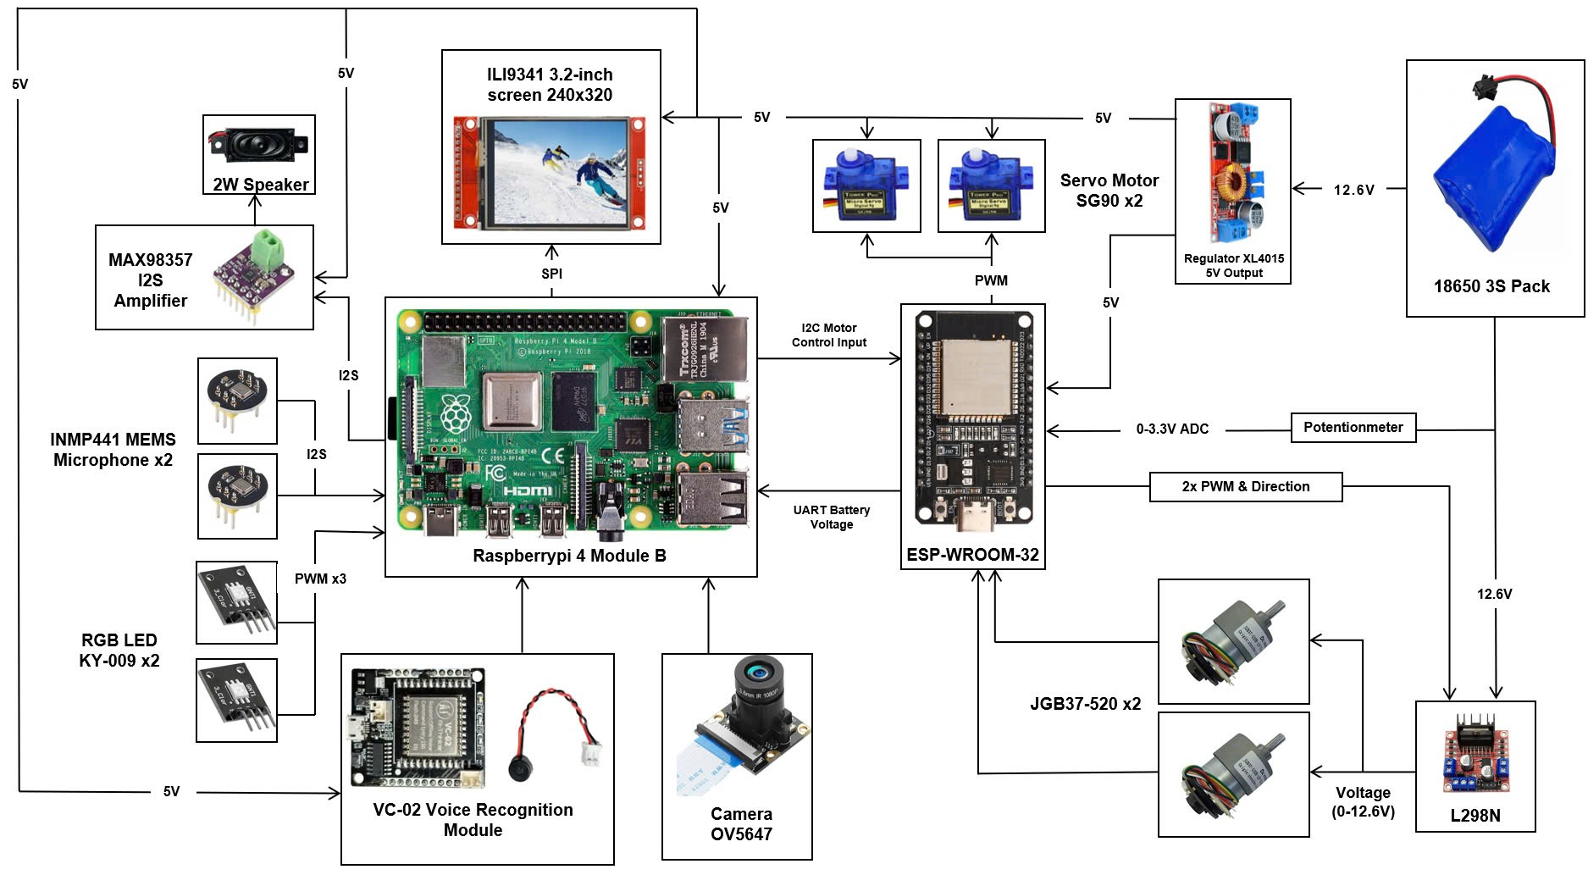

Slide 6
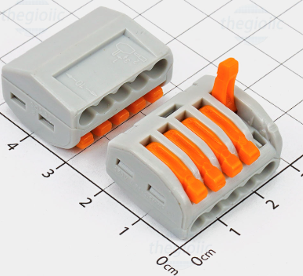
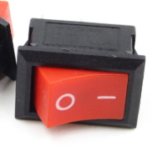
Regulator XL4015
5V Output
12.6V
12.6V
12.6V
12.6V
12.6V
PCB đọc pin
18650 3S Pack
12.6V
L298N
LM2596S USB
5V Output

